Slide 1
Prineville Local Implementation Team
Technical Tools and Resources
Technical Tools Meeting
June 15, 2020

Slide 2
Setting the Stage
Purpose is to review existing tools and information sources across landownerships to guide the Prineville LIT work.
Tools and resources can be used for:
  Understanding where project work has occurred in the past, across all agencies & jurisdictions
  Estimating the distribution and severity of threats
  Prioritizing where to work for best return on investment
  Measuring success and adaptive management

Slide 3
Question 2:
Estimating the Distribution and Severity of Threats
There are several vegetation maps available
  See list
Overview of two major map sources:
  Landscape Planning Tool
    Southeast Oregon vegetation composition map
    Many other data layers
  Rangeland Analysis Platform
    New maps just released

Slide 4
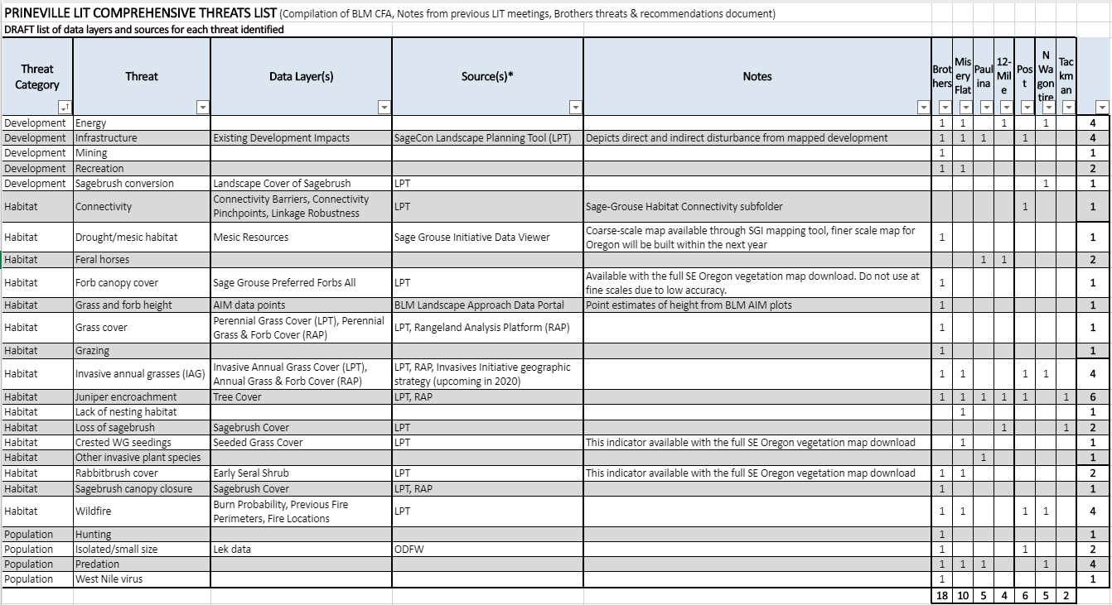
Threats Table and Technical Resources

Slide 5
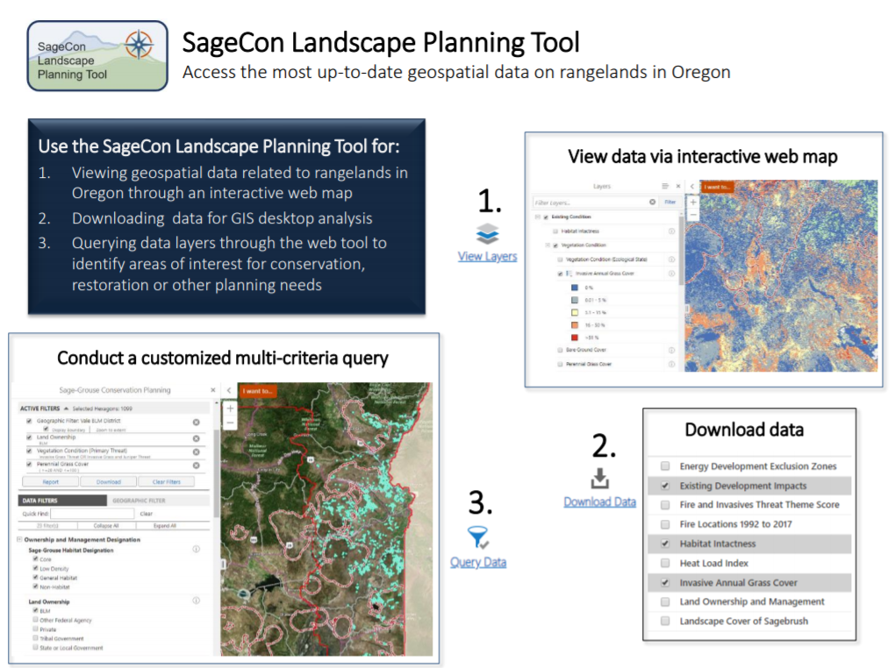
Overview of the Landscape Planning Tool

Slide 6
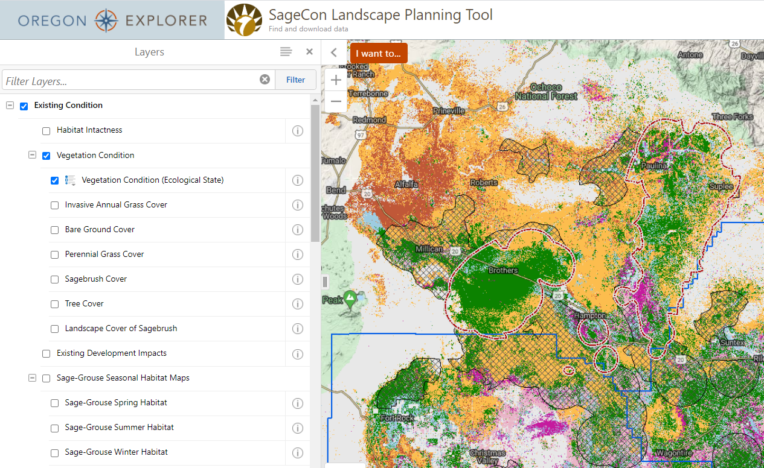
SageCon Landscape Planning Tool
https://tools.oregonexplorer.info/OE_HtmlViewer/Index.html?viewer=sagegrouse

Slide 7
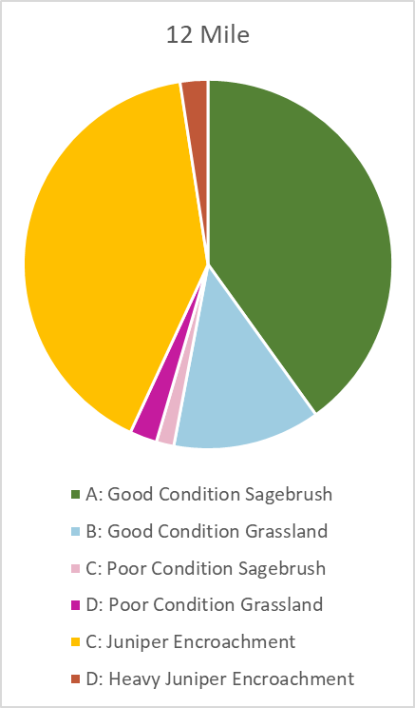
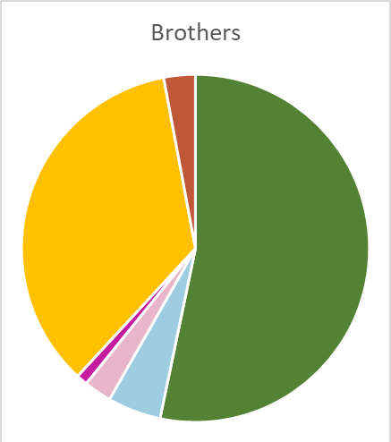
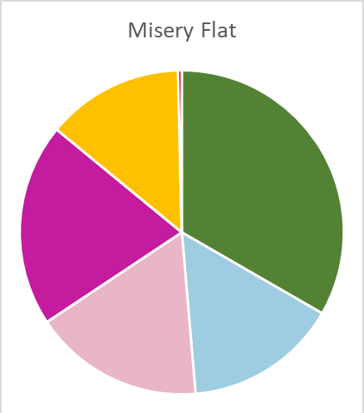
SageCon Landscape Planning Tool
Southeast Oregon vegetation composition map
  Many vegetation indicators available
    Primary indicators: ecostate, cover of perennial grass, invasive annual grass, tree, sagebrush
    Other indicators: cover of deep-rooted perennial grass, sage-grouse preferred forbs, introduced seeded grasses, etc
    Accuracy varies by indicator
  Maps should not be used at very fine scales

Slide 8
SageCon Landscape Planning Tool
Southeast Oregon vegetation composition map
  Many vegetation indicators available
    Primary indicators: cover of perennial grass, invasive annual grass, tree, sagebrush
    Other indicators: cover of deep-rooted perennial grass, sage-grouse preferred forbs, introduced seeded grasses, etc
    Accuracy varies by indicator
  Maps should not be used at very fine scales
Sage-grouse seasonal habitat (spring, summer, winter)
Habitat connectivity
Development impacts (direct and indirect)
Restoration potential
Theme scores – fire & invasives, biodiversity significance
Burn probability and previous fire perimeters

Slide 9
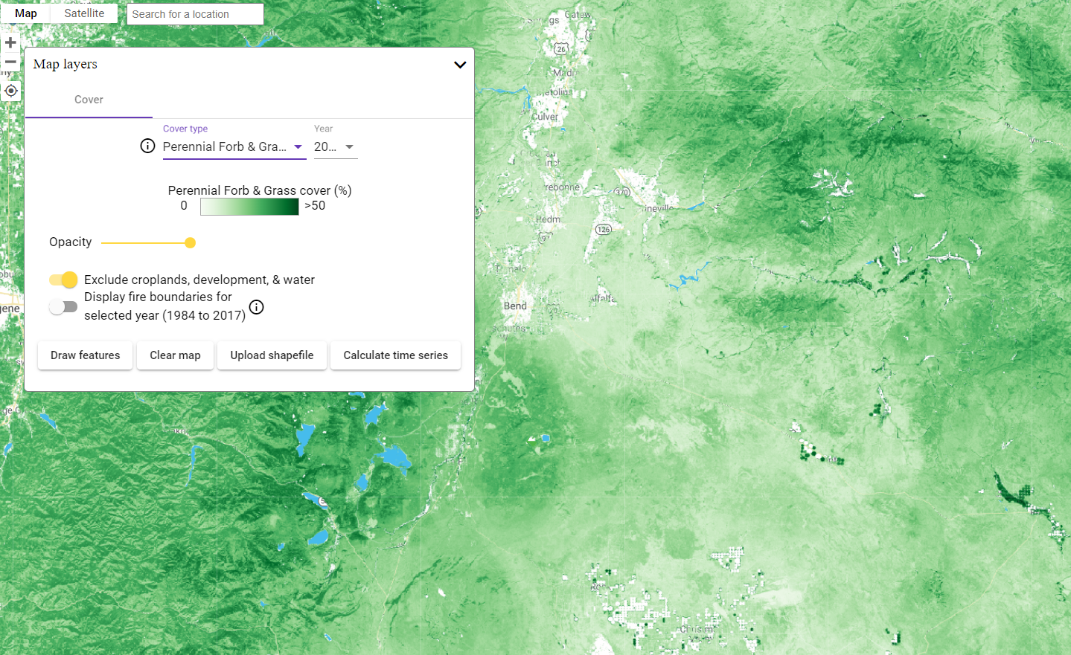
Rangeland Analysis Platform
Yearly maps from 1984-2019 of:
Perennial grass & forb cover
Annual grass & forb cover
Shrub cover
Tree cover
Bare ground cover
https://rangelands.app/

Slide 10
Threats Table and Technical Resources
Questions to the group:
What other data sets or information sources have you used?
What other local datasets exist to address these threats?
Next steps

Slide 11
Question 1:
Understanding where project work has occurred in the past, across all agencies & jurisdictions
Conservation Efforts Database (CED)

Slide 12
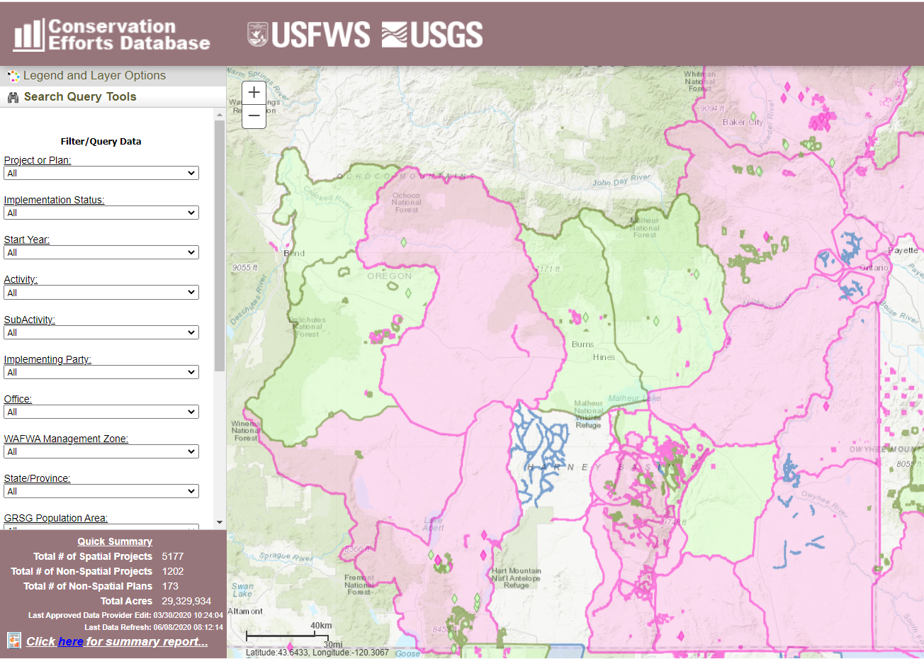
Conservation Efforts Database (CED)
Captures conservation actions to benefit the sagebrush ecosystem across all partners and landownerships in 11 Western states
https://conservationefforts.org/

Slide 13
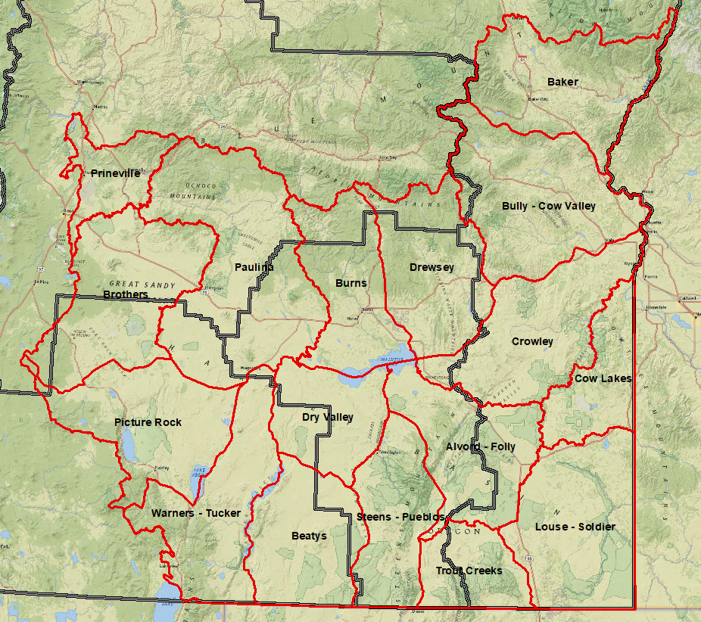
Conservation Efforts Database (CED)
Captures projects across all agencies and landownerships
Data call still ongoing – all data expected this summer
Private lands reporting is by Sagebrush Reporting Unit (SRU) (red)
More detailed reporting on private lands available from partners?
https://conservationefforts.org/

